Slide 1
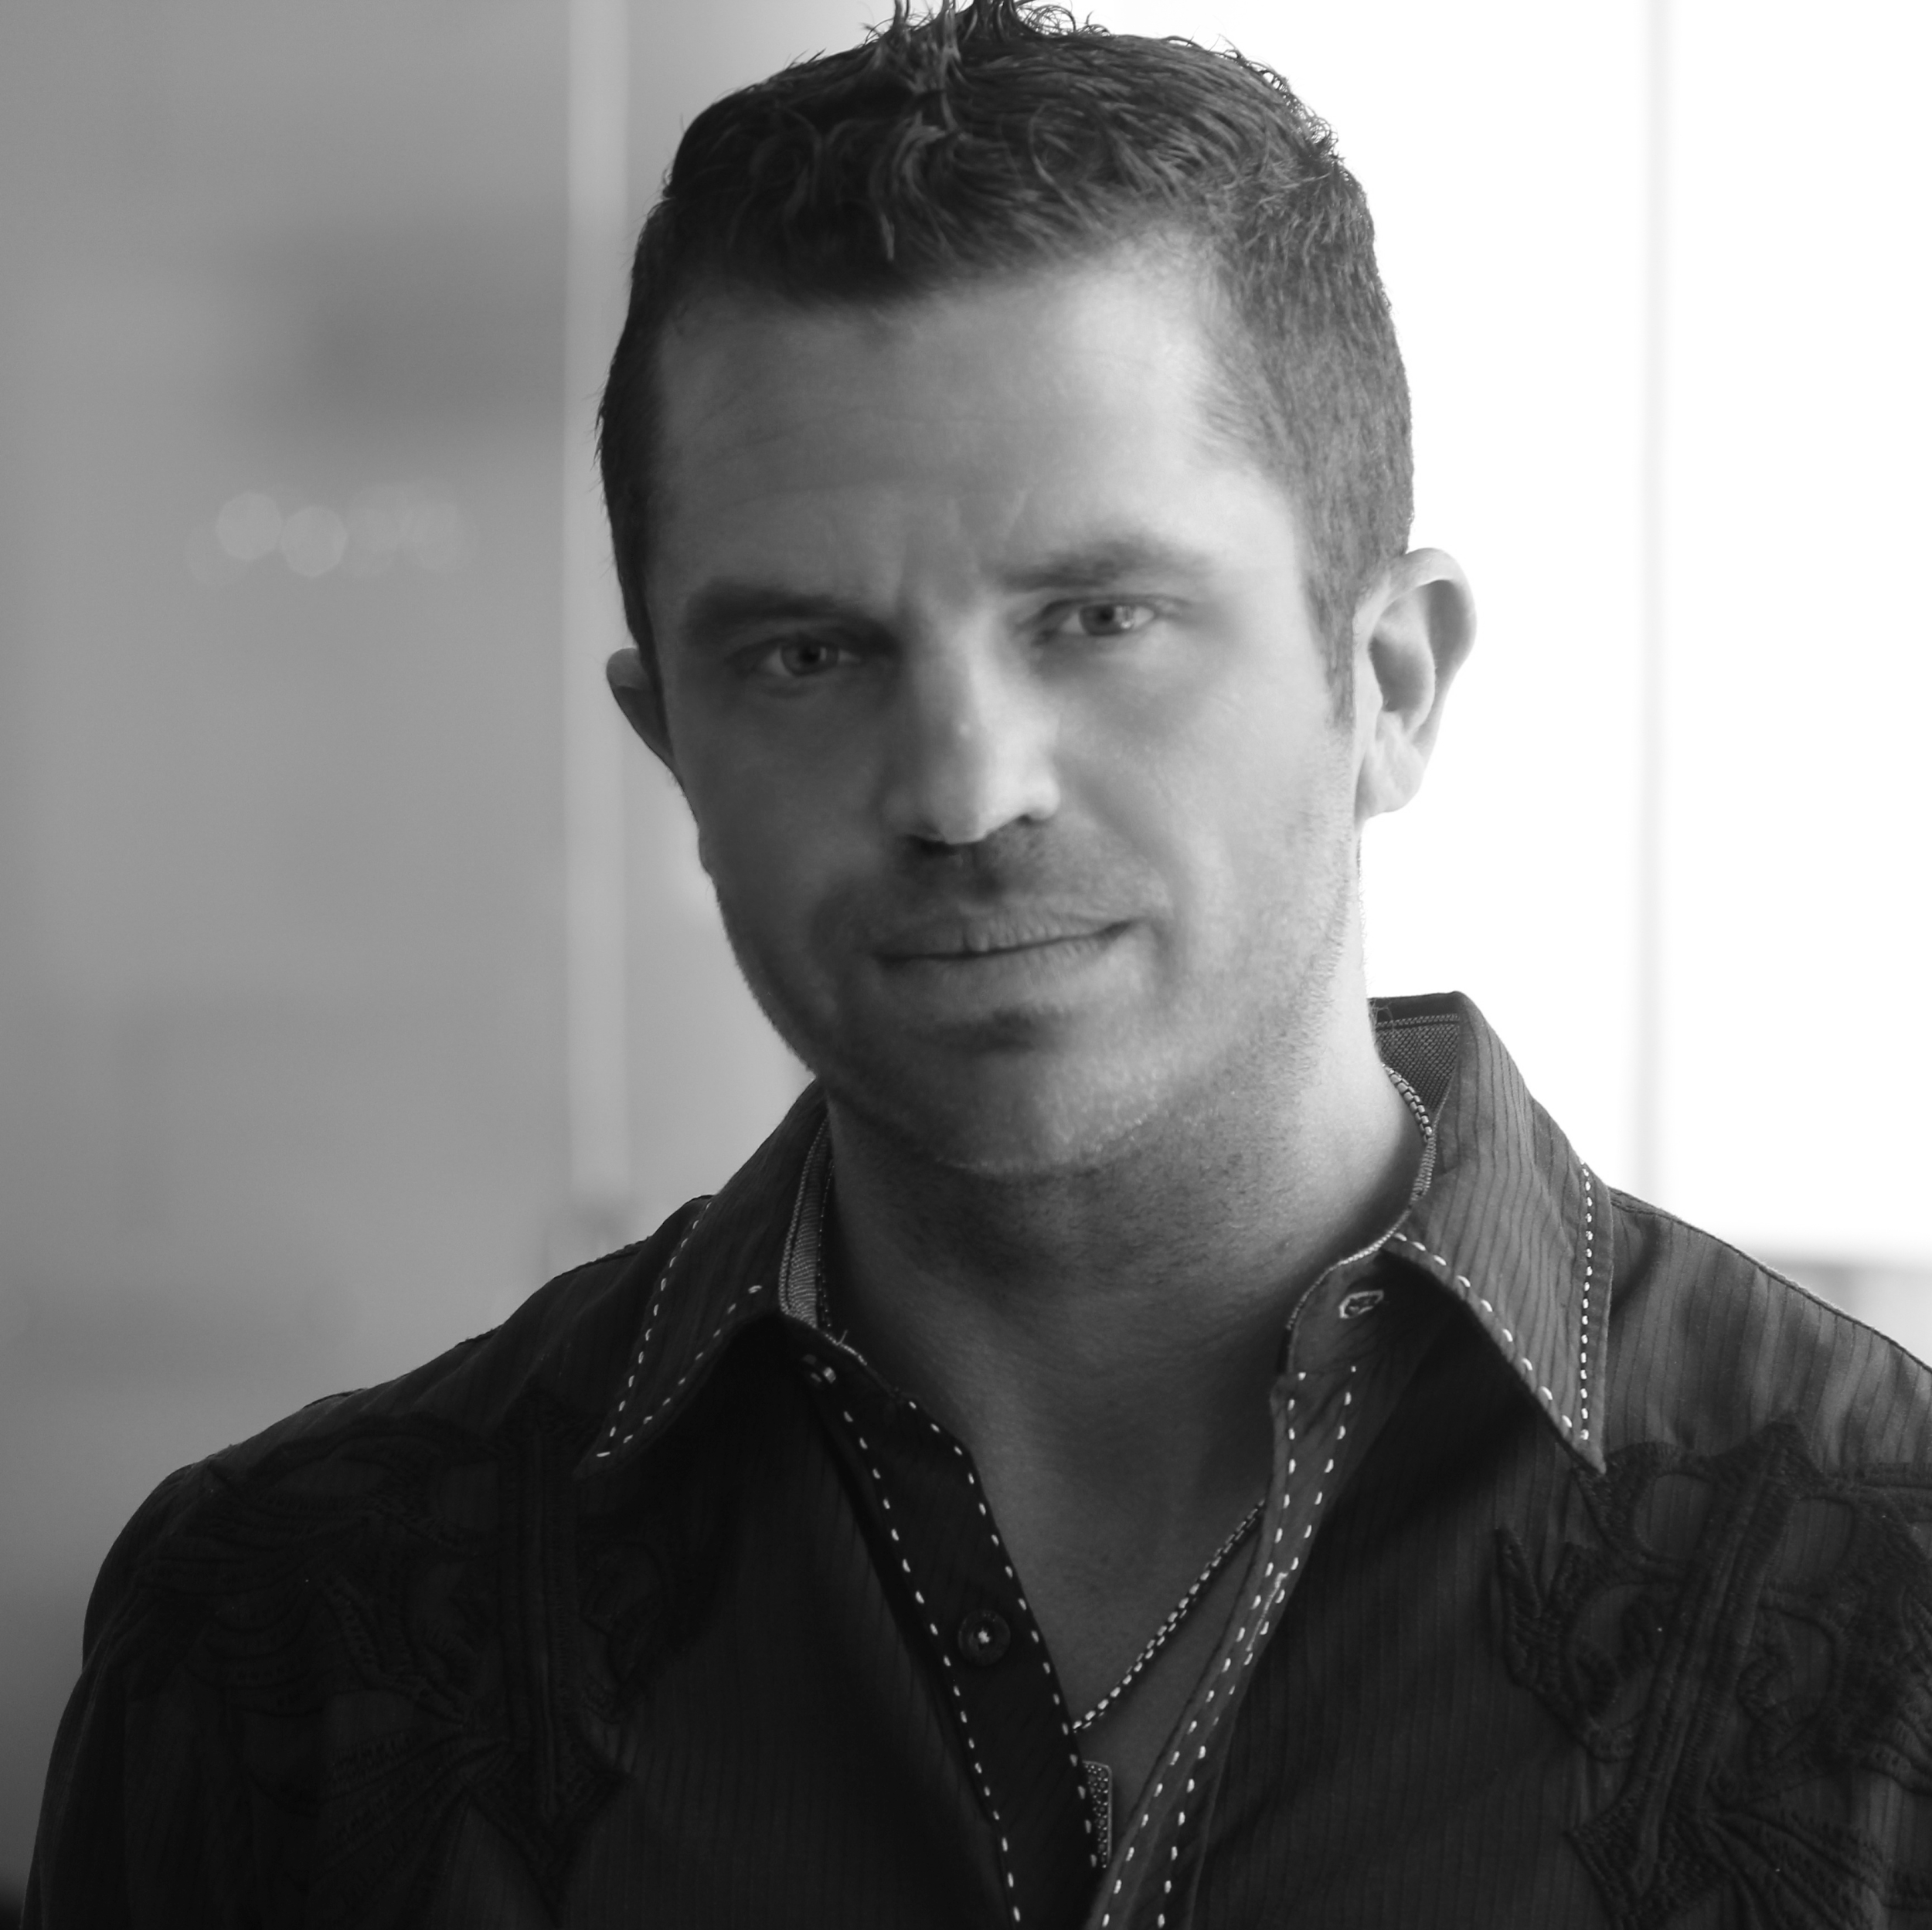
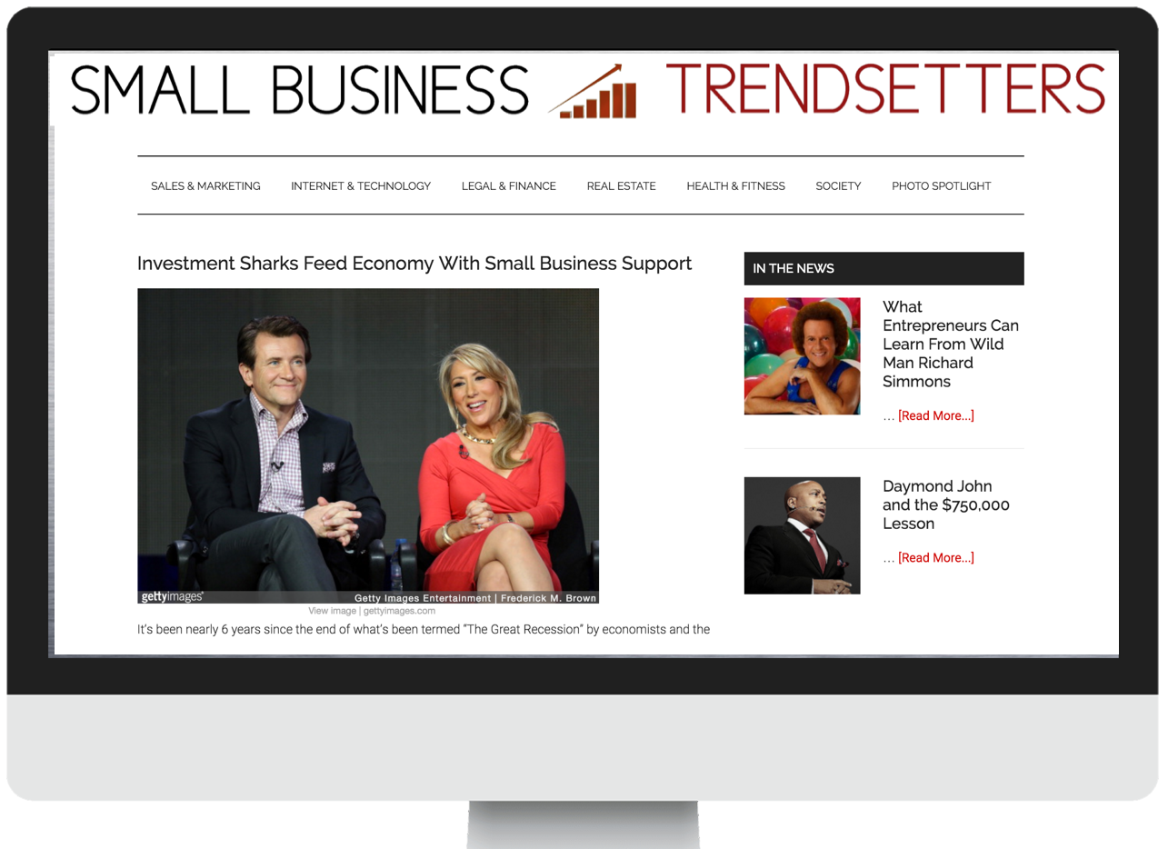
ONE TIME OFFER
EXPIRES 10/31/2015
Let me get your business on
YOUR NAME, Professional Authority Media Agent
Founder of YOUR COMPANY
I CAN MAKE YOU A CELEBRITY.
I want to include your business in my next photo essay for Small Business Trendsetters online magazine and make you a celebrity...for FREE.
Now, I’m not talking about being a celebrity like Taylor Swift or Jimmy Fallon. You don’t have to be anywhere near that famous.
I mean making you celebrity in your own teeny tiny corner of the world… to the people that do business with you.
If you, in any way, rely on knowledge, expertise or credibility to stand out from your competitors, then this will give an advantage that instantly makes you the obvious choice to all of them.
This advantage moves products off the shelf, attracts the best customers and earns the highest fees. It stimulates a cycle of success that continually brings in new business every month.
We call this advantage “authority positioning”...and we've discovered the easy formula to create it for business owners like you.
..and to prove this to you, I will include your business in a photo essay in Small Business Trendsetters, then show you how to use that appearance to get more customers.
THE 3 SIMPLE STEPS.
STEP 1: EMAIL ME THE PICTURE
Contact me at xxx-xxx-xxxx or xxxx@xxxxxx.com to find out the type of pictures needed. Then just email it to me!
STEP 2: I PUBLISH IT
I’ll publish a photo essay about your business in Small Business Trendsetters within days of receiving the image from you.
STEP 3: GET MORE CUSTOMERS
I show you how to use that appearance to bring more customers into your business.
YOUR BIZ
NAME HERE, LLC.
123 Anystreet Ln, City, ST 12345
Email: email@google.com | Phone: 123-456-7890

